Slide 1
Lecture-4
Geographical Aspects

Slide 2
Sessons and Climate
Bangladesh has a subtropical monsoon climate characterized by wide seasonal variations in rainfall, moderately warm temperatures, and high humidity. The monsoonal wind causes heavy rainfall.
Traditionally Bangladeshis subdivide the year into six seasons: Grismo (summer), Barsha (rainy), Sharat (autumn), Hemanto (cool), Sheet (winter), and Bashonto (spring). However, four seasons are distinguishable: The winter ( December - February), Summer (March-May), Monsoon ( June-September) and Autumn ( October-November).
During Summer and Monsoon tropical Cyclones, Tornadoes, Flood and drought are very common. Average temperature is minimum 7.22 degree C, maximum 37.80 degree C. In Dhaka the average temperature in January is about 19° C (about 66° F), and in May about 29° C (about 84° F).

Slide 3
River
Bangladesh is a land of rivers.
There are more than 700 rivers and their tributaries crisscross the country constituting a water way of total length around 24,140 km.
Most of the country’s land formed through silt brought by the rivers.

Slide 4
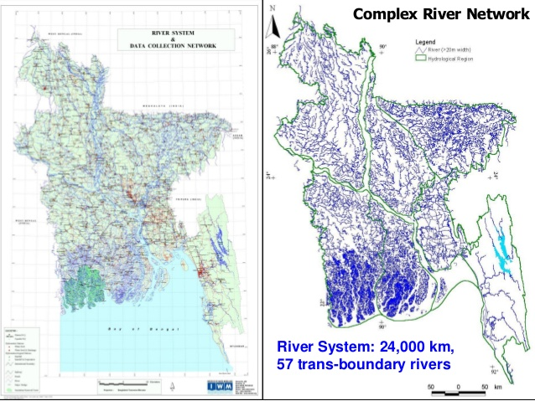
River
The principal rivers of Bangladesh are the Padma, the Meghna, the Jamuna. The Karnafulli etc
Most of these rivers rise from the Himalayas and fall into the Bay of Bengal.
River system
Brahmaputra –Jamuna System
The Genges-Padma system
Surma-Meghna system

Slide 5
River
Importance of rivers
Agriculture
Livelihood
Transport
Trade & Commerce
Electricity
Tourism
Art and Literature

Slide 6
River
Present condition of rivers
Though we have a lot of rivers, many rivers have almost lost its appeal & beauty.
Buriganga is the first in this list.
There are some other rivers like the Padma, the karnafuli, the Sheetalakha are getting polluted day by day because of industrial reasons.

Slide 7
Soil
The major part of Bangladesh in on the Delta form by the three major rivers Padma, Megna and Jamuna.
The huge sediments carried by these rivers are the major sources of formation of 80% of soils of the country.
The remaining 20% of soils have been formed in Tertiary and Quaternary sediments of hills (12%) and in uplifted Pleistocene terrace.

Slide 8
Soil
Soil Erosion caused by
1. Natural Process-
Water flowing Down hill
Wind
Slope of the land
2. Human activities
Over cropping
Overgrazing
Deforestation

Slide 9
Soil
Effects of Soil Erosion
Loss of top soil- this is the biggest effect of soil erosion because top soil is so fertile, if it is removed, this can cause serious harm to farmers crops or the ability to effectively work their land.
Soil compaction- when soil under the topsoil becomes compacted, it reduces the ability of water to infiltrate. Runoff increases which cause more erosion.
Reduced organic and fertile matter- removing topsoil reduces the ability o of land to generate new flora or crops

Slide 10
Soil
Poor drainage- too much compaction with sand can cuase poor drainage.
Soil acidity level- when organic matter reduced there is a chance of increasing acidity which will impact the ability for plants and crops to grow.
Water pollution: Run off with sediments and pesticides from soil can cause water pollution. This can damage the fish and water quality.

Slide 11
Flora & Fauna
Bangladesh is rich in fauna, including nearly 250 indigenous species of mammals, 750 types of birds, 150 kinds of reptiles and amphibians, and 200 varieties of marine and freshwater fish.
The Sundarbans area is one of the principal remaining domains of the Royal Bengal tiger, and herds of elephants and many leopards inhabit the Chittagong Hill Tracts. Other animals living in Bangladesh include mongoose, jackal, Bengal fox, wild boar, parakeet, kingfisher, vulture, and swamp crocodile.
Valuable trees in Bangladesh, include sundari (hence the name Sundarbans), gewa, sal, and garan. Village groves include fruit trees (mango and jackfruit). The country also has many varieties of bamboo.

Slide 12
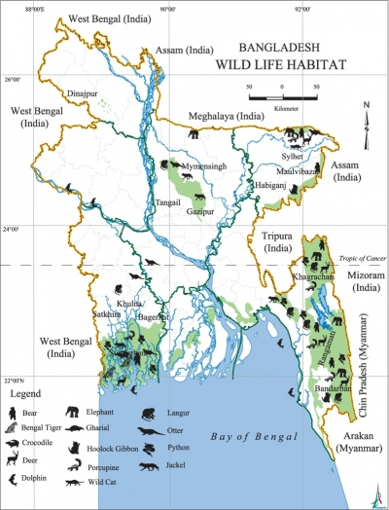

Slide 13
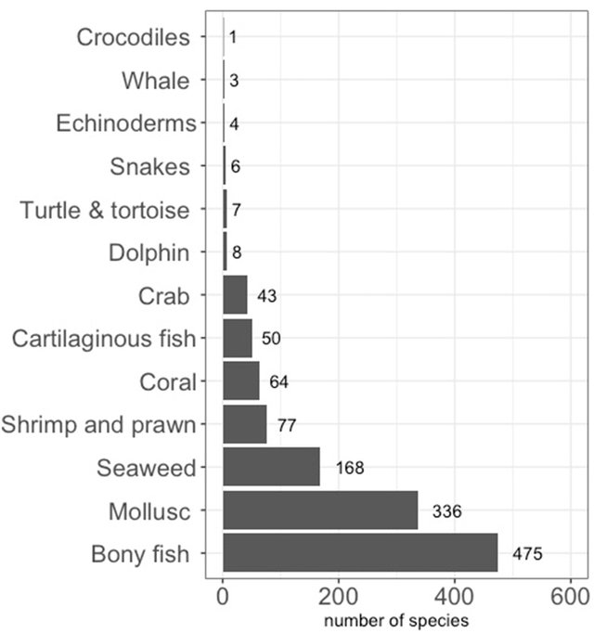
Fig. Marine fauna and flora diversity of Bangladesh (total = 1242).

Slide 14
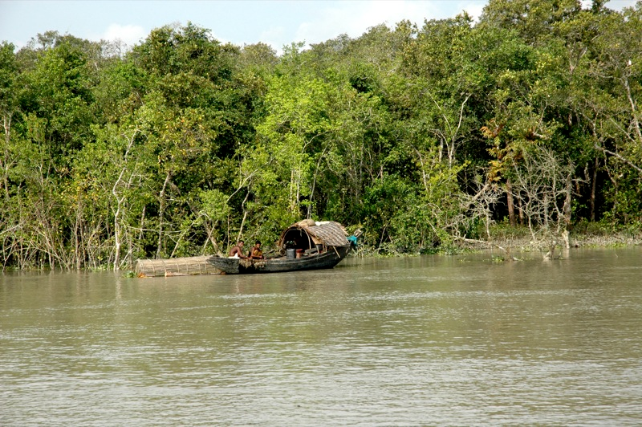

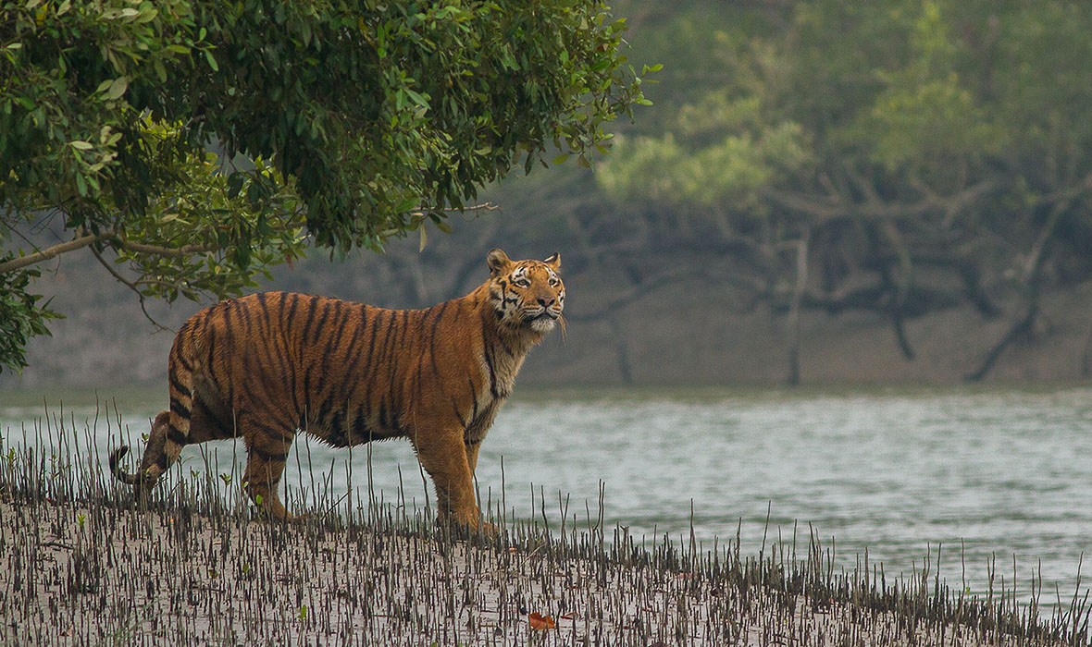
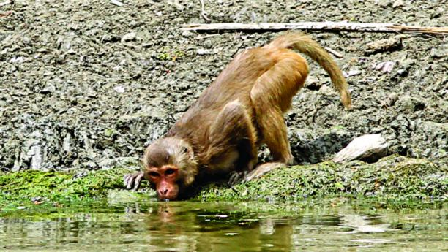

Slide 15



Slide 16

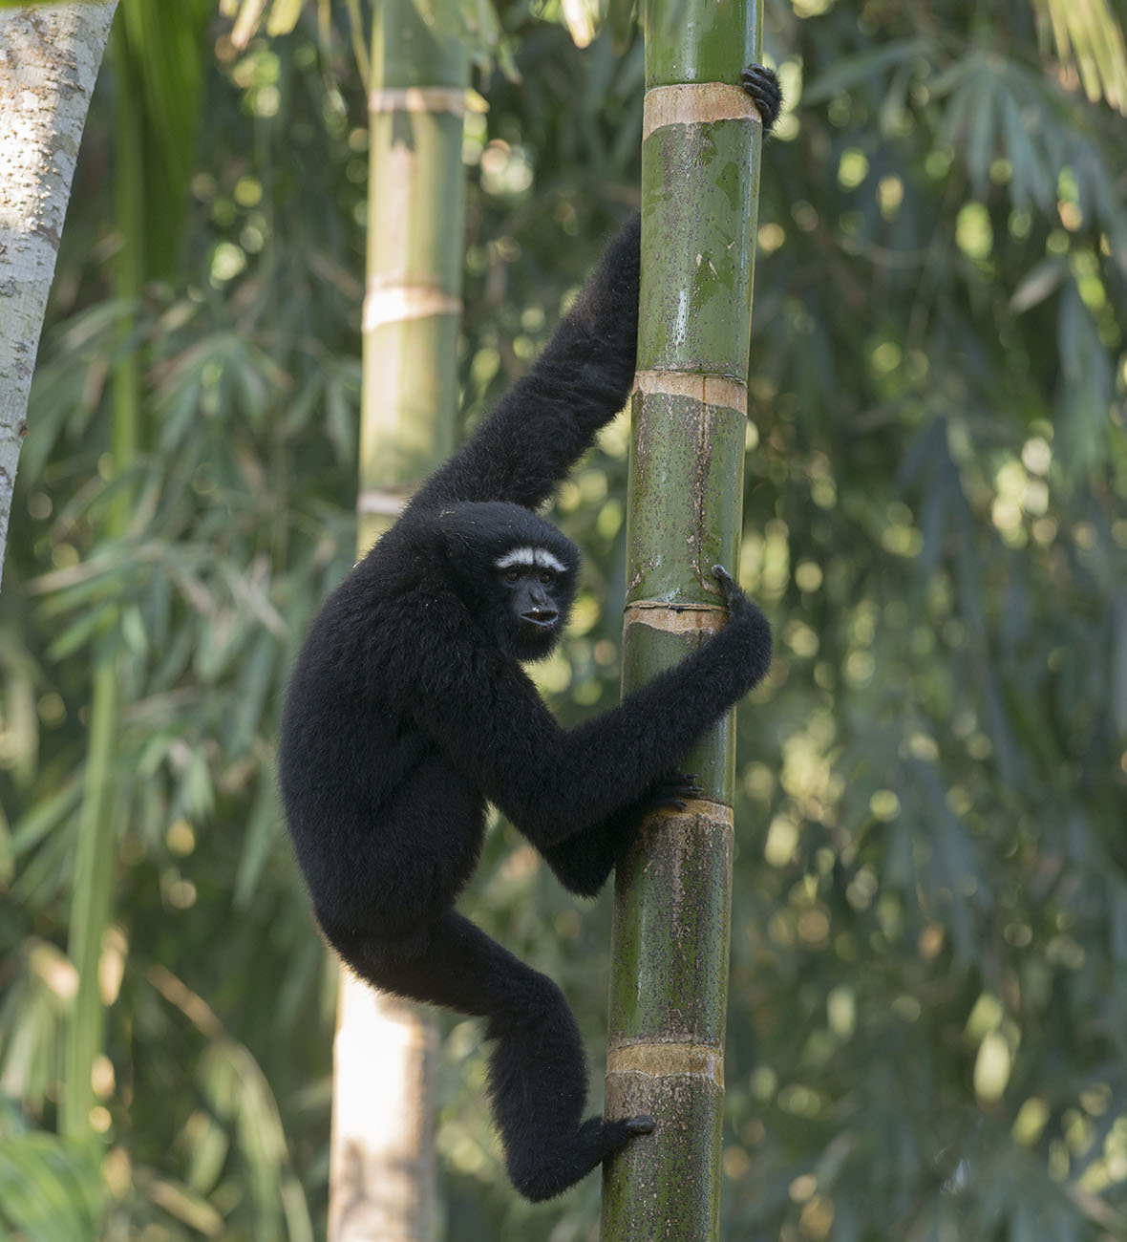


Rare animals

Slide 17

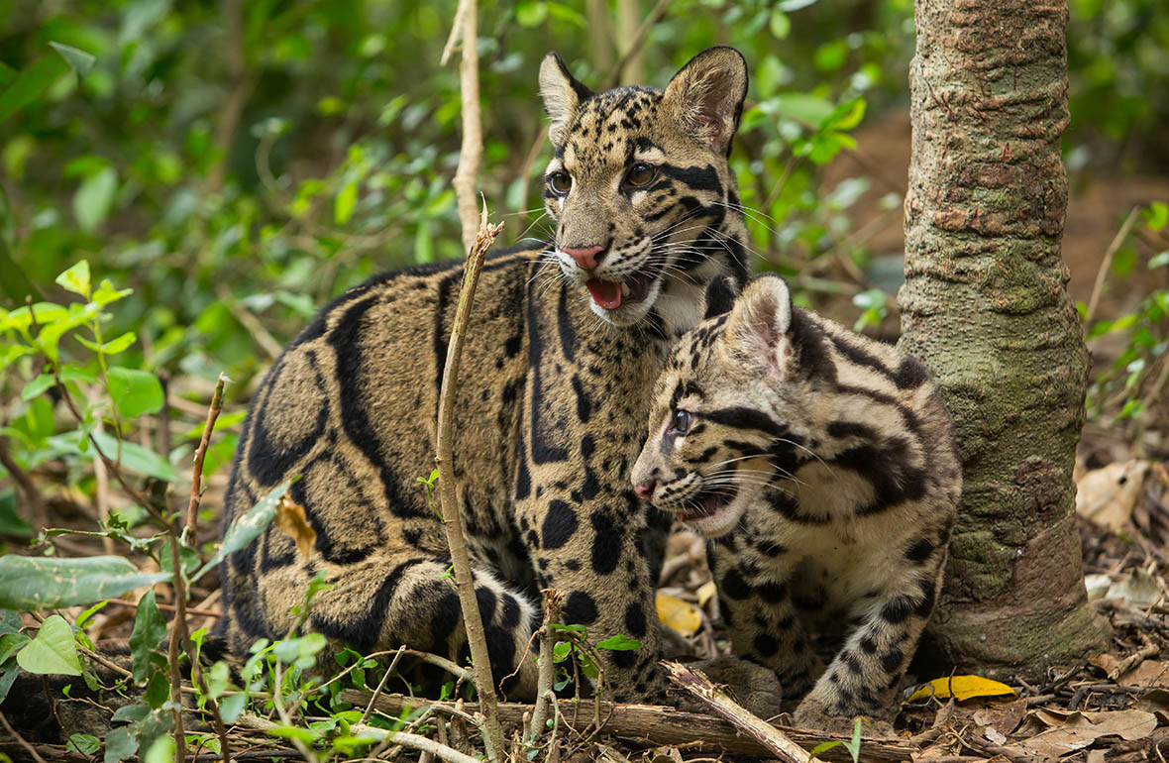

Slide 18
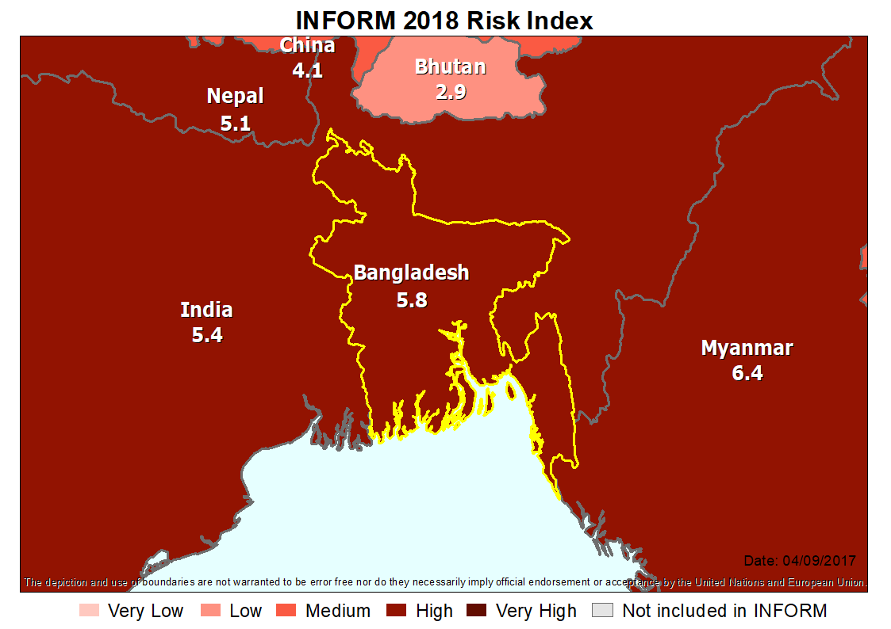
Major Natural Disaster of Bangladesh
Bangladesh is prone to many kinds of natural disasters. Of these natural disasters, the most important ones to mention are tropical cyclones with associated storm-surges, floods, droughts, tornadoes and river-bank erosions.

Slide 19
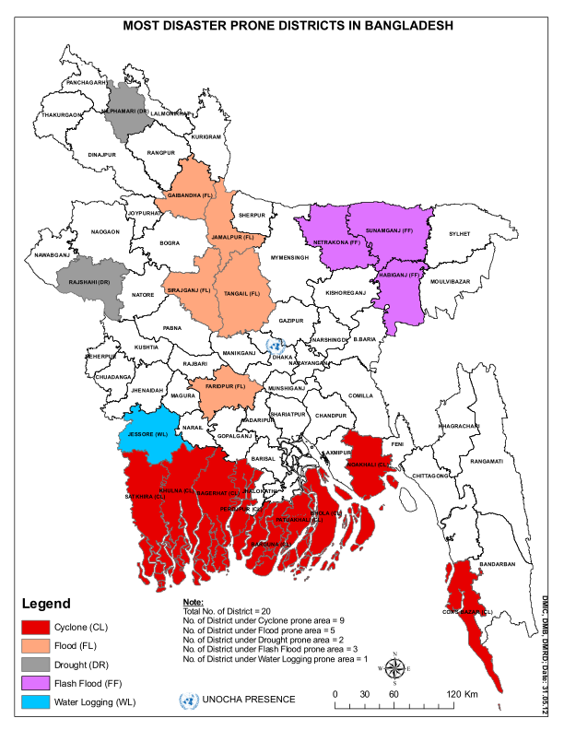

Slide 20
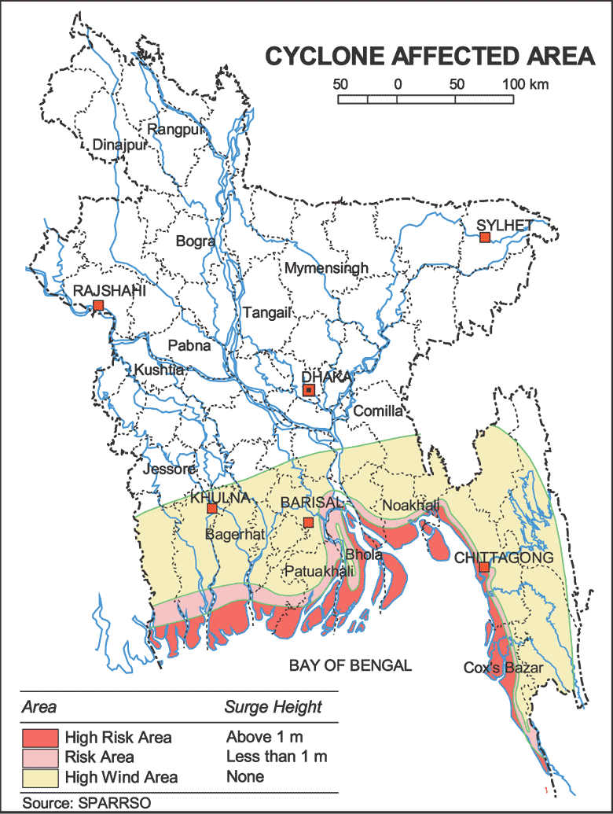
Cyclones:
Tropical cyclones are frequent in the Bay of Bengal. Cyclone, tropical cyclone, hurricane, and typhoon are different names for the same phenomenon of a cyclonic storm system that forms over the oceans. Tropical cyclones can result in extensive flooding and storm surge and causes devastating damage. Bangladesh, due to its unique geographic location, suffers from devastating tropical cyclones frequently. The funnel-shaped northern portion of the Bay of Bengal causes tidal bores when cyclones make landfall, and thousands of people living in the coastal areas are affected.
The cyclone disasters in 1970 ( 300,000 dead) and 1991 (138,000 dead) are among the worst natural disasters in the world.

Slide 21
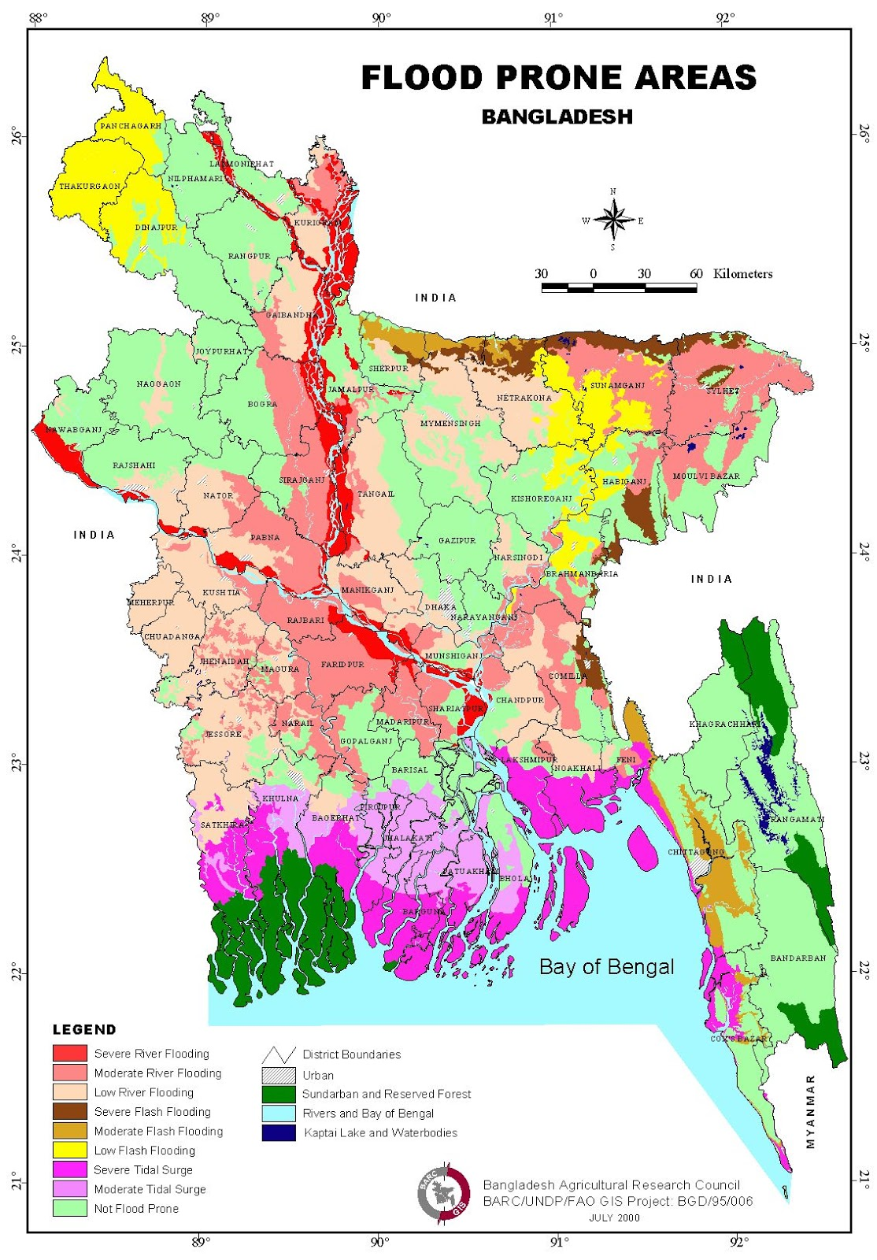
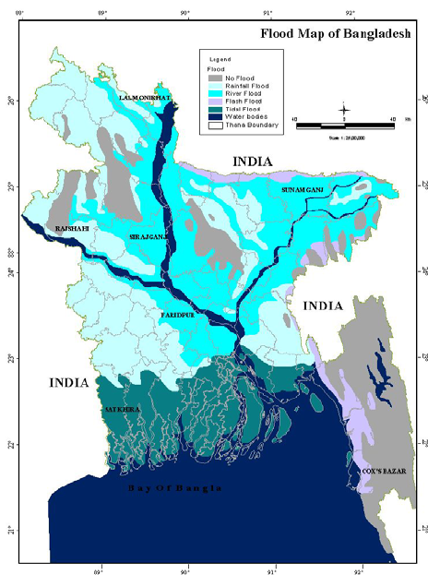
Floods
Floods in Bangladesh are a complex phenomenon. In August-September,1988, Bangladesh experienced an unprecedented flood causing loss of 1657 human lives.

Slide 22
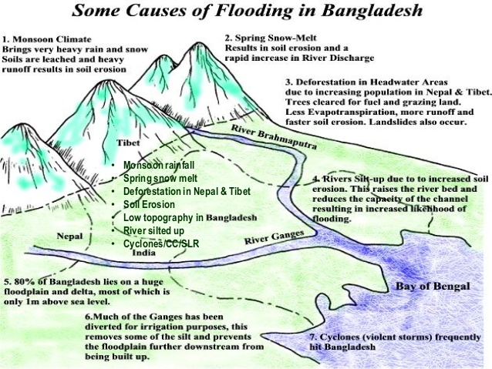

Slide 23
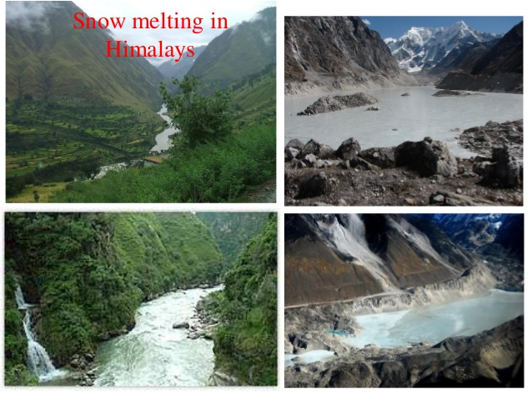

Slide 24
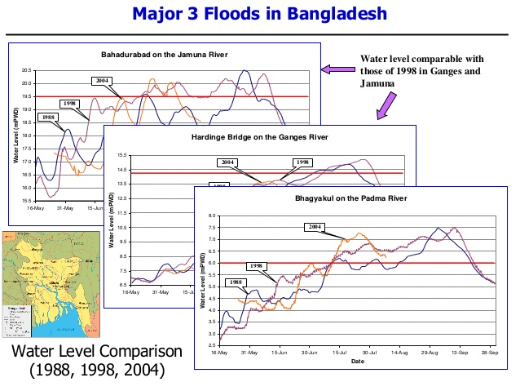

Slide 25
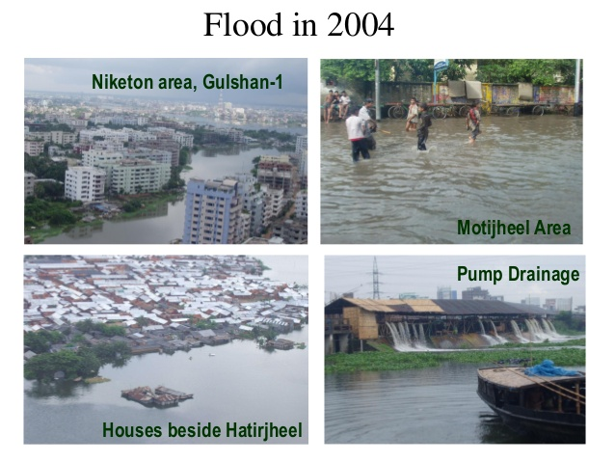
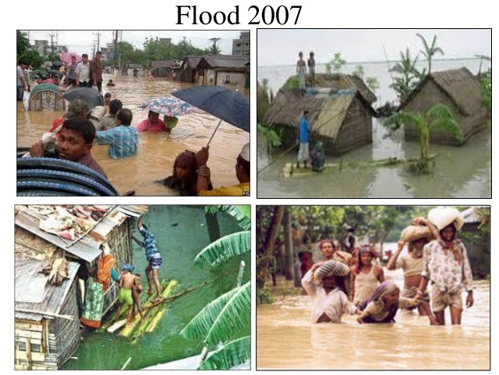

Slide 26
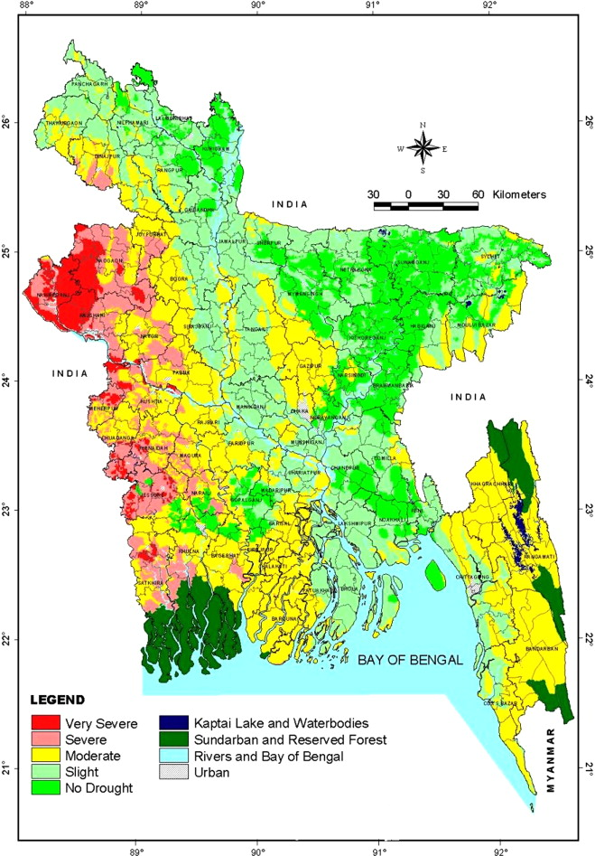
Droughts:
Bangladesh experiences Drought conditions at some intervals of time. In 1979 Bangladesh passed through a major drought year which was trend by many as the worst in the recent past.

Slide 27
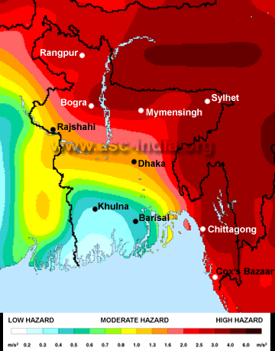
Major Natural Hazards/Disasters of Bangladesh
Earthquakes:
Bangladesh has potentiality for earthquake hazards as per the recorded history. According to GSHAP data, Bangladesh lies in a region with low to high seismic hazard that increases in the northern and eastern parts of the country. Historically, earthquakes in the M6.0-7.0 range have been experienced in Chittagong, Dhaka and Sylhet divisions while events in the M5.0-6.0 range have been experienced in Khulna and Rajshahi divisions.

Slide 28
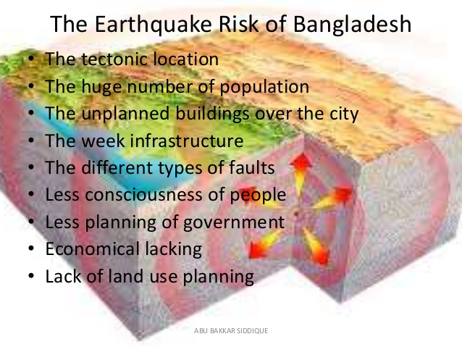

Slide 29
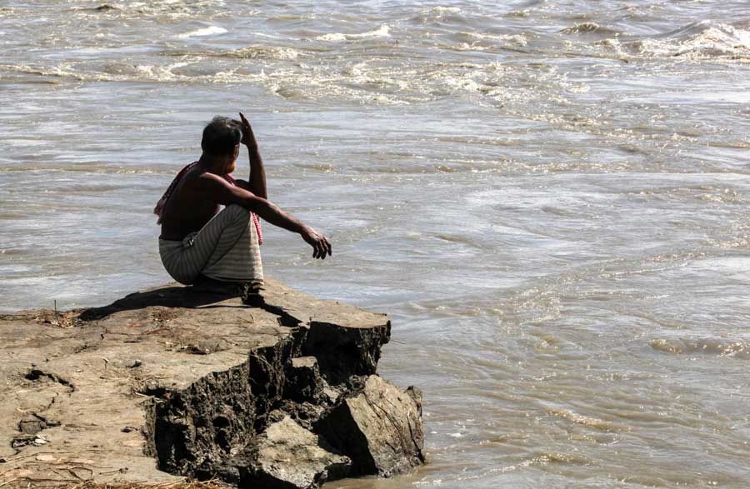
River bank erosions:
Riverbank erosion, one of the major natural disasters in Bangladesh, causes untold miseries every year to thousands of people living along the banks of the rivers. Along the courses of the mighty rivers, like Jamuna, Meghna, etc. erosion every year takes away chunks of land causing displacement of large number of people and losses of properties.
Bangladesh is projected to lose around 2,270 hectares of land this year due to riverbank erosion, a study report has said.

Slide 30
Tornadoes:
Bangladesh has been facing the severe tornado incidents from the historical ages due to its geographical location. In recent years, it becomes more frequent; even hit the land more than six times in a year. Tornadoes cause localized devastation and demand an immediate response. A severe tornado hit Tangail district of the country on 13th May 1996 causing 540 death and injuring about 34000 people. Loss of cattle heads and damages to homes were also substantial.
Arsenic contamination:
The contamination of groundwater by arsenic in Bangladesh is one of the largest poisoning of a population in the history. The scale of this environmental poisoning disaster is greater than any seen before.

Slide 31
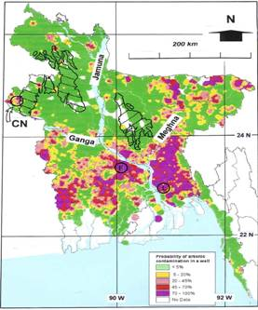
Arsenic map of Bangladesh (DPHE, 2000)

Slide 32
Impacts of Disasters
•Climate Change Impacts
•Agriculture
•Salinity Intrusion
•Forests
•Fisheries
•Ecosystem and Biodiversity
Emergency relief from abroad:
The major help came from Japan, USAID, India, Canada, Saudi Arabia, UAE, European Union, World Bank, ADB, 1DB, ODA etc.

Slide 33
How environment influence people
The temperate climate of Bengal also make people mild and amicable.it endowed them with finer sentiments which sweetened their home life as well as social life.
The food, dress, transport and various other aspects of life were conditioned by the nature. The plains of Bengal produced rice abundantly and its rivers supplied plenty of fishes. Hence these are the main foods of this region.
The climate of the country acted like the third line of defense against the outside attack.

Slide 34
How environment influence people
The geographical peculiarities, such as natural barriers on the borders, the innumerable rivers and waterways through the plains, the marshes, rains and climate conditioned the life and culture of its people through the ages.
The geography and nature subsequently helped Bengal/Bangladesh in maintaining an independent political career for several centuries. It maintained an independent existence throughout the Hindu period, with the exception of a few years under Asoka and about a century in the reigns of the imperial guptas. In muslim period Bengal remained practically independent ever since its conquest by Ikhtiar-Uddin Muhammad bin bakhtiar khalji in 1204-1205ad.

